Slide 1
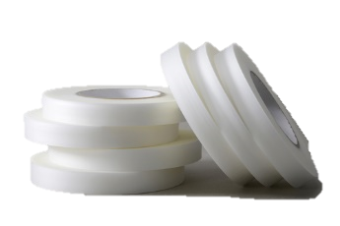
口罩系列
防護衣系列
醫療床
其他
SAN FANG
MEDICAL MATERIALS
03
Protective Clothing
All series
INDUSTRY
CHEMICAL
PPE Fabrics
PROTECTIVE CLOTHING
PROTECTIVE CLOTHING
NPC-100
NPC-200
Material | TPE + PP Spunbond | TPE + PP Spunbond
Basis Weight | 60±6 gsm | 60±6 gsm
Width | MAX 60 inch | MAX 60 inch
Hydrostatic Pressure Test | 200 cm-H₂O | 200 cm-H₂O
Impact Penetration Test | < 0.01 g | < 0.01 g
Penetration Of Synthetic Blood | ASTM F1670 / EN14126 Pass | ASTM F1670 / EN14126 Pass
Penetration Of Phi-x174 Bacteriophage | ASTM F1671 / EN14126 Pass | ASTM F1671 / EN14126 Pass
Electrostatic Properties | EN 1149-1 Pass | EN 1149-1 Pass
Liquid Chemicals to Penetration | - | EN ISO 6530 Pass
Application | AAMI PB70 LEVEL 4 | Hazardous Area
MPC-100
MPC-200
MPC-300
Material | PE + PP Spunbond | TPE + PP Spunbond | TPE + PP Spunbond
Basis Weight | 65±6 gsm | 50±5 gsm | 83±5 gsm
Width | MAX 60 inch | MAX 60 inch | MAX 60 inch
Hydrostatic Pressure Test | 100 cm-H₂O | 160 cm-H₂O | 220 cm-H₂O
Impact Penetration Test | < 0.01 g | < 0.01 g | < 0.01 g
Moisture Permeability | - | 1,500 g/m².24h | 2,369 g/m².24h
Standard | CNS14798 P1 AAMI PB70 LEVEL1 - LEVEL 3 | CNS14798 P2 AAMI PB70 LEVEL1 - LEVEL 3 | CNS14798 P3 AAMI PB70 LEVEL 4
Accessory | PPC-100 | TPC-100 | TPC-200
Product | Liquid-proof Tape | Liquid-proof Tape | Liquid-proof Tape
Material | PP + PE | TPE | TPE
Hydrostatic Pressure Test | 120 cm-H2O | 150 cm-H2O | 150 cm-H2O
PPC-100
TPC- 100
TPC- 200

